Slide 1

Go Local Staff 3
Team Member:
Daylin Gonzalez
Product Owner:
Eduardo Garcia

Slide 2
Problem
Event organizers always rely on staffing agencies in order to find and manage the required staff to host events. This is a difficult and resource intensive process which raises some issues like:
High overhead costs
Agencies Application process is lengthy for staff
Limited number of registered staff to agencies
Process has to be during agencies business hours
GoLocalStaff solve all four problems

Slide 3
Requirements: User stories implemented
Staff registration
Staff profile information set up
Staff resume posting
Event organizer login
Event organizer logout
Event organizer search for staff by criteria
Event organizer view staff contact information

Slide 4
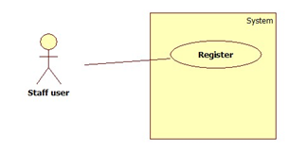
Use case: Staff registration
USER STORY DESCRIPTION: As a user, I need to be able to create an account, so that I can use the GoLocalStaff services.
Actors:
Staff
Pre-Conditions:
User is on the registration page
DESCRIPTION:
Use case begins when the user clicks on the signup button.
The user proceeds to enter his or her credentials in the form’s fields.
The user clicks on the submit button to submit his or her information.
Use case ends when the system notifies the user that a new account was created.

Slide 5
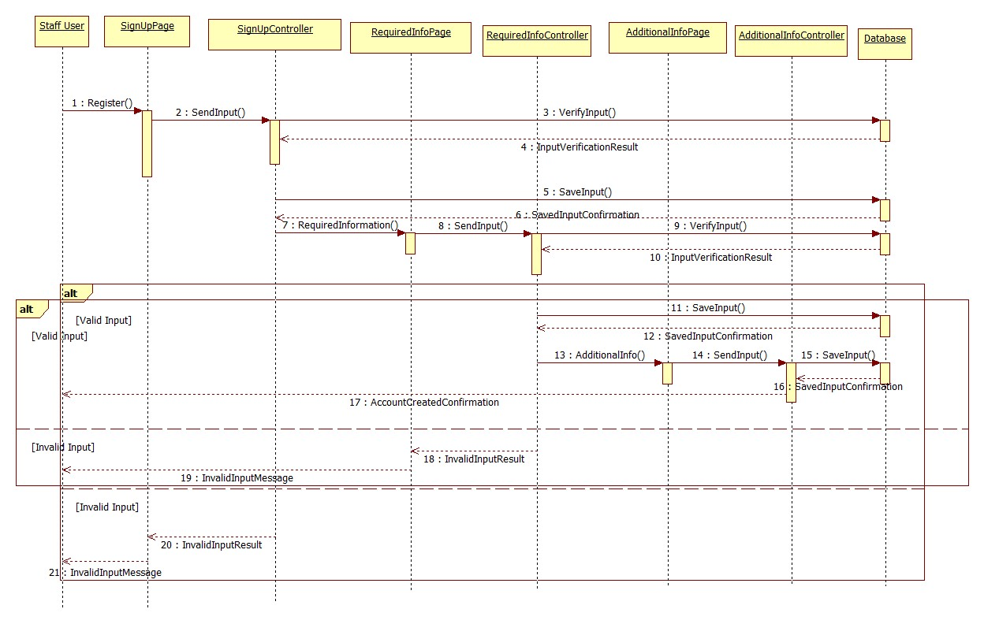
Sequence Diagram: Staff Registration

Slide 6
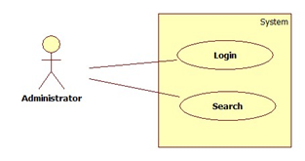
Use case: Database query page
USER STORY DESCRIPTION: As a developer, I have to implement a database query page for the current website so administrator can search for staffs registered in the GoLocalStaff service
Actors:
Administrator
Pre-Conditions:
There exist registered staffs in the database
DESCRIPTION:
Use case begins when the administrator enter his username and password to log in.
The Administrator fill the criteria fields and press Enter
Use case ends when the system displays a page with all the registered staffs that satisfy the criteria

Slide 7
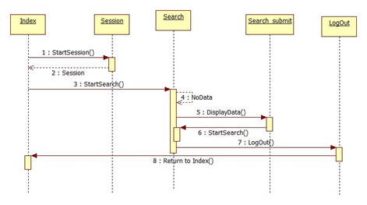
Sequence Diagram: Database query page

Slide 8
System Design: System Decomposition

Slide 9
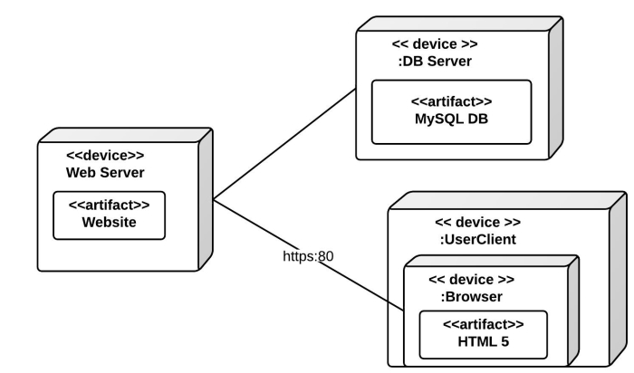
System Design: System Deployment

Slide 10
Security/Privacy
Password Hashing
Data Validation
Access Control rules
Secure registration process

Slide 11
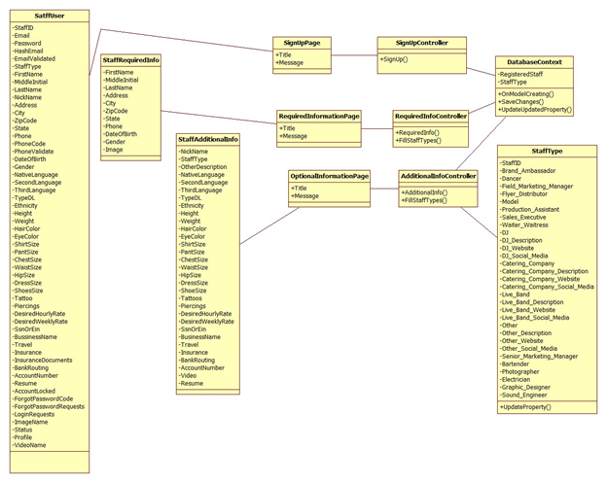
Detailed Design: Class Diagram

Slide 12
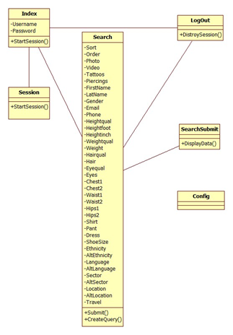
Detailed Design: Class Diagram

Slide 13
Sunny Test
Test Case for Staff Registration
Purpose: To enable users in creating a staff account
Preconditions:
User is connected to the internet
User is at the registration page
Inputs: User fills out the registration page by entering the required information.
Expected Output:
User receives a notification that the account was created

Slide 14
Rainy Test
Test Case for Staff Registration
Purpose: Prevent user from entering malicious input when creating an account
Preconditions:
User is connected to the internet
User is at the registration page
Inputs: User fills out the registration page by entering malicious inputs.
Expected Output:
Warns user of his or her inputs and allow him to reenter the information.

Slide 15
Sunny Test
Test Case for Database Query Page
Purpose: To enable users to log in
Preconditions:
User is connected to the internet
User is at the registration page
Inputs: User enters username and password.
Expected Output:
System displays search page

Slide 16
Rainy Test
Test Case for Database Query Page
Purpose: To enable users to log in
Preconditions:
User is connected to the internet
User is at the database query page
Inputs: User enters invalid username and/or password.
Expected Output:
System notifies user that username or password is invalid

